Slide 1
Convolutional Neural Networks with TensorFlow

Slide 2
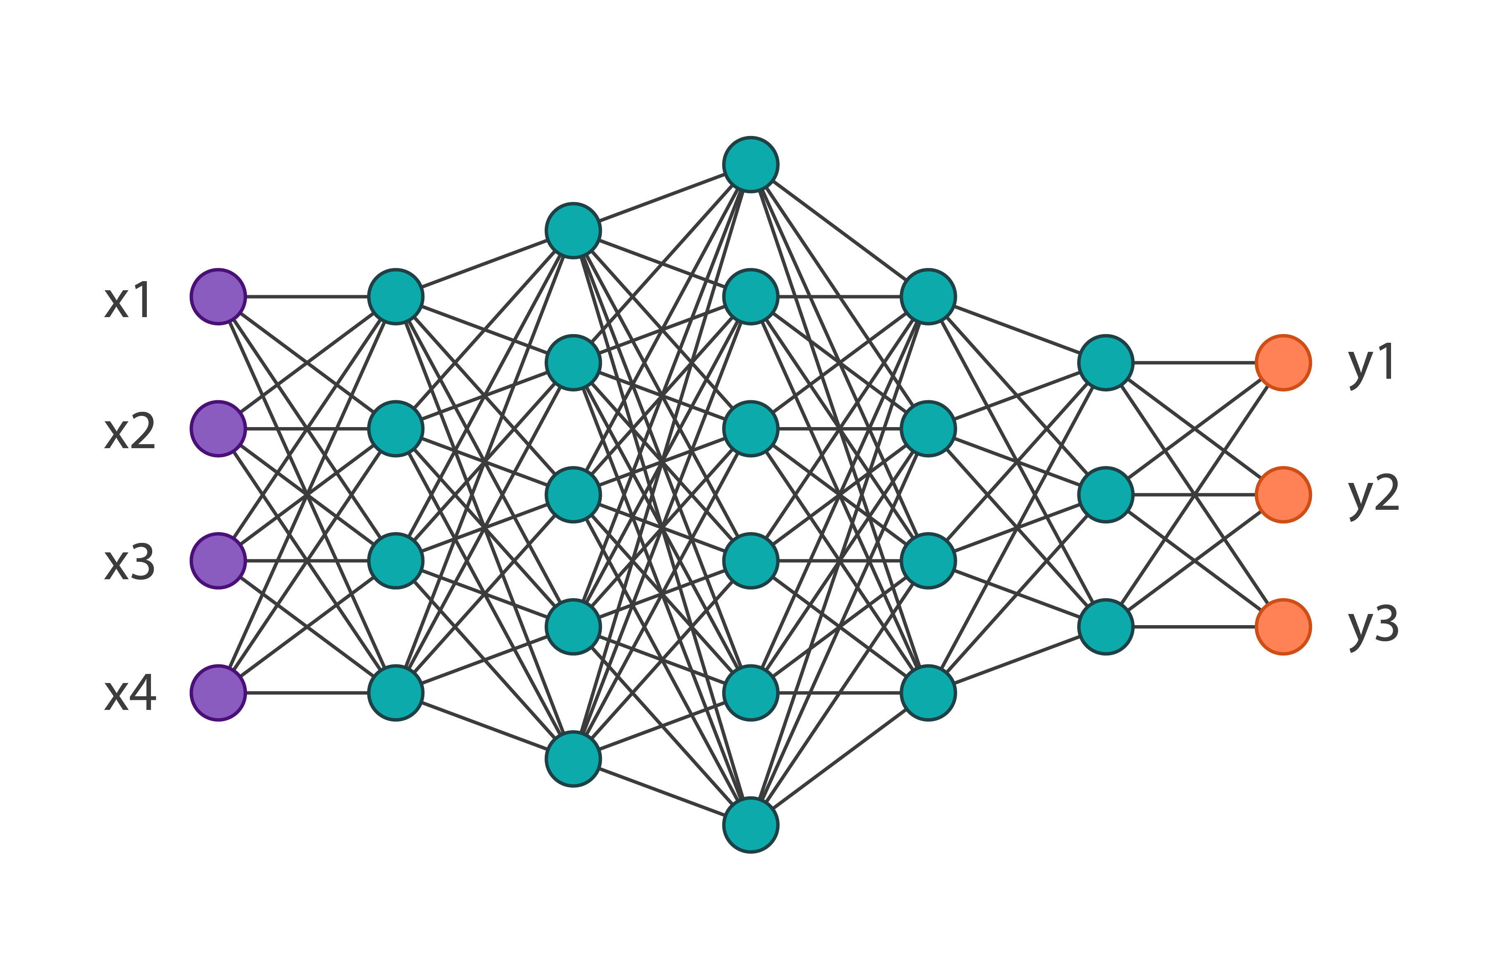
You know How typical Neural network looks like..

Slide 3
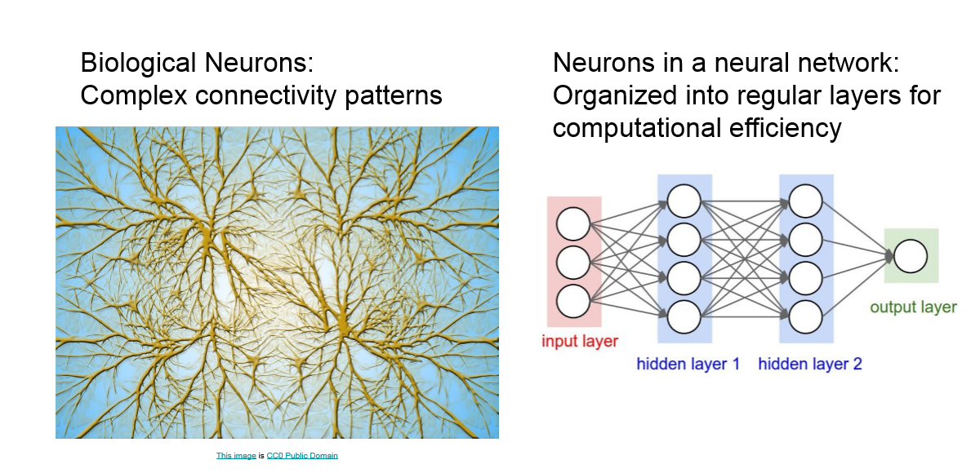

Slide 4
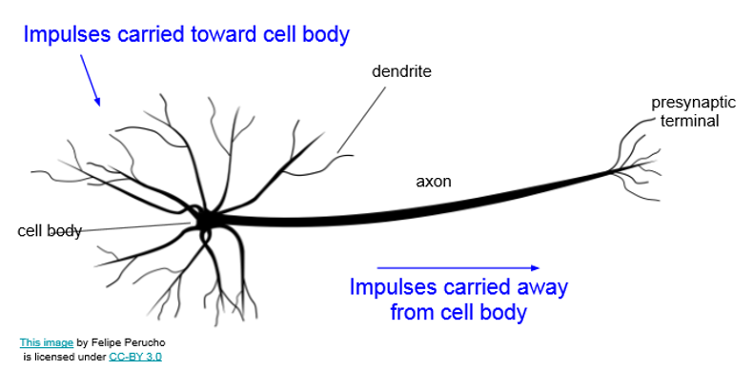

Slide 5
Why Deep Learning?

Slide 6
Shallow ML vs Deep learning
Shallow ML: Learns greedily (in successive manner). Stacking multiple shallow learners together will not achieve the same results.
Deep Learning: The layers learn the patterns jointly

Slide 7
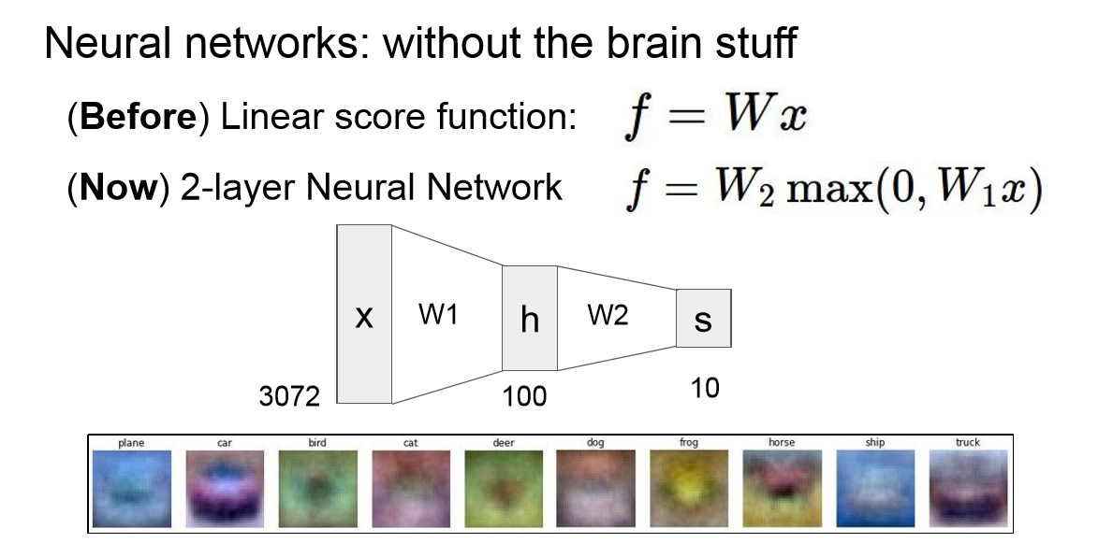

Slide 8
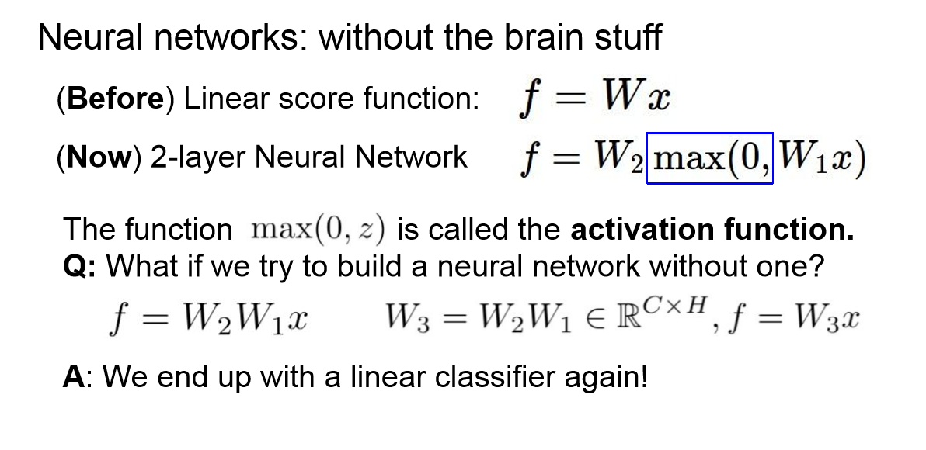

Slide 9
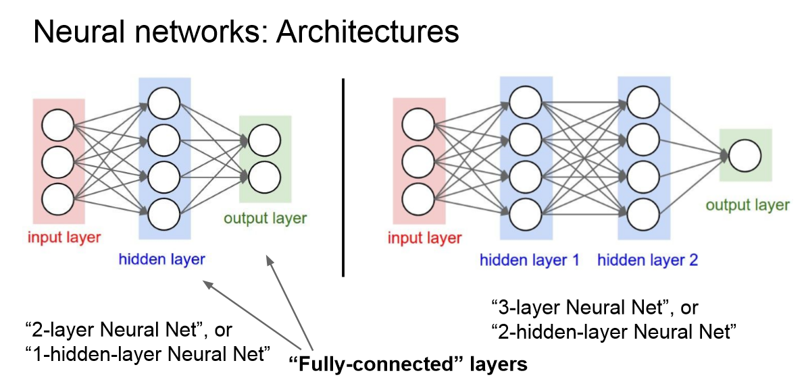

Slide 10
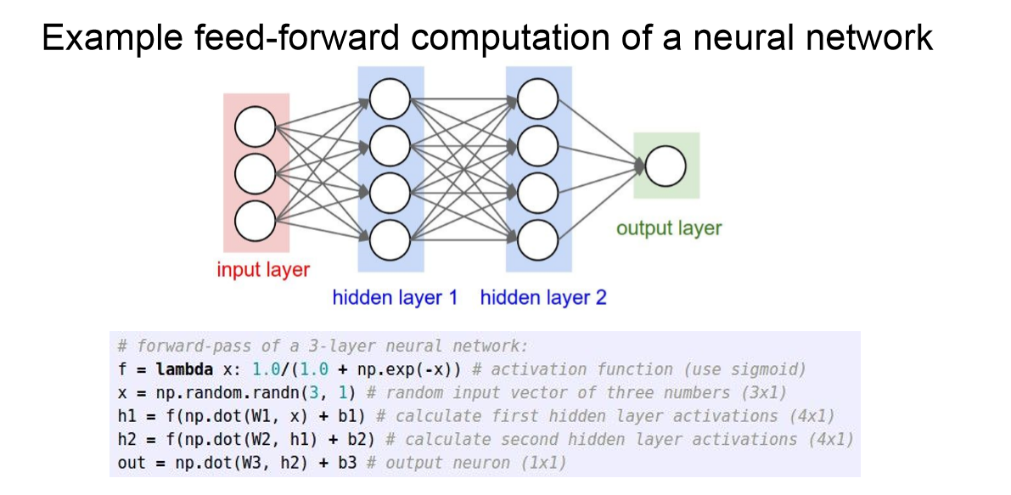

Slide 11
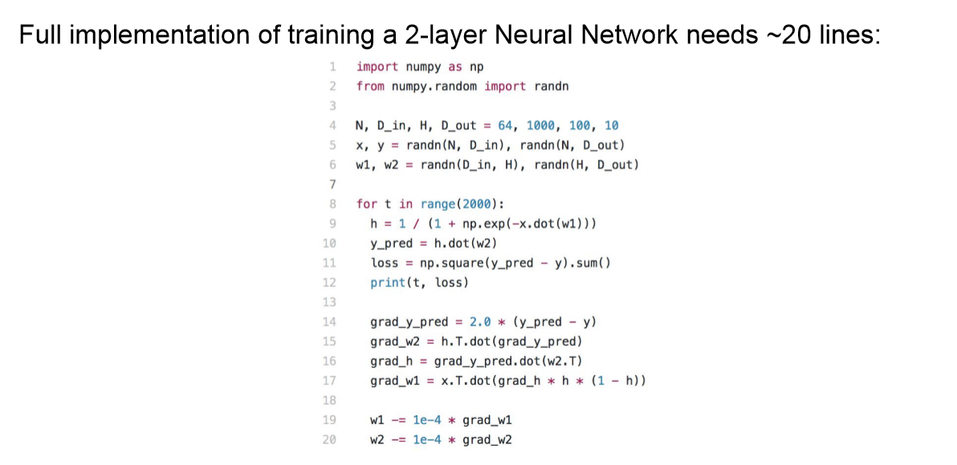

Slide 12
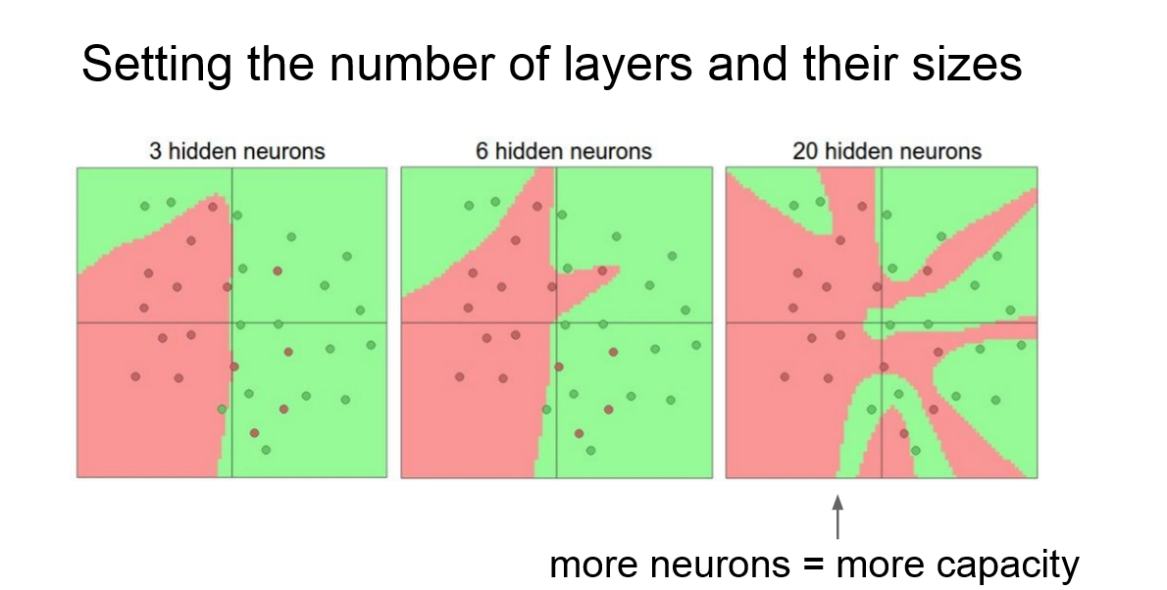

Slide 13
Popular Deep Learning Libraries
TensorFlow (Google)
Theano (University of Montreal)
PyTorch (Facebook)
Caffe (Berkeley)

Slide 14
Let’s dive into TensorFlow

Slide 15
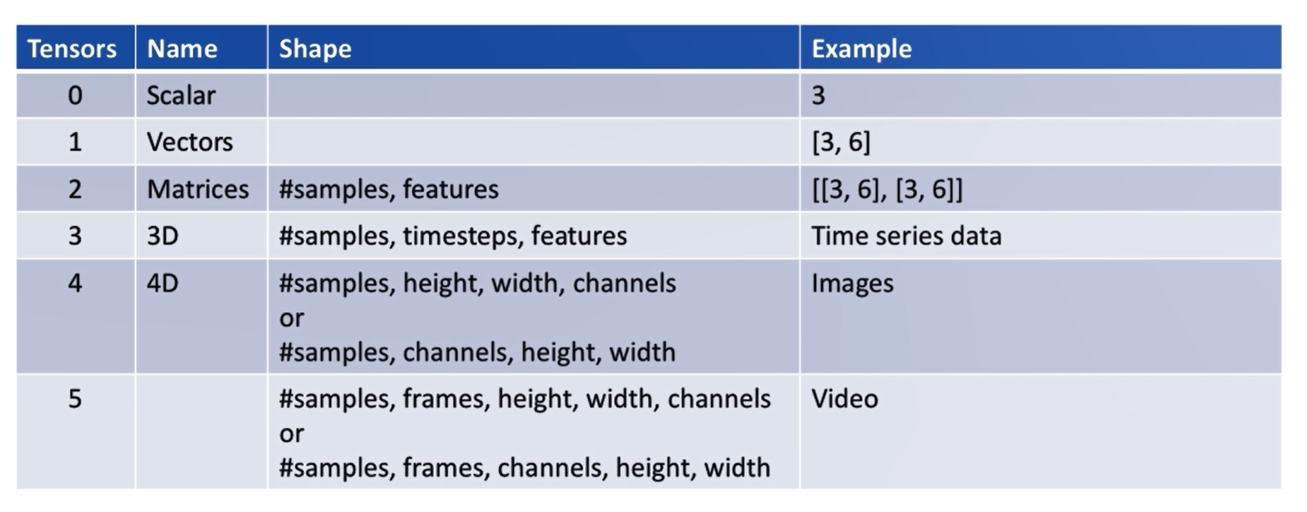
What’s a tensor?
A tensor is a data container

Slide 16
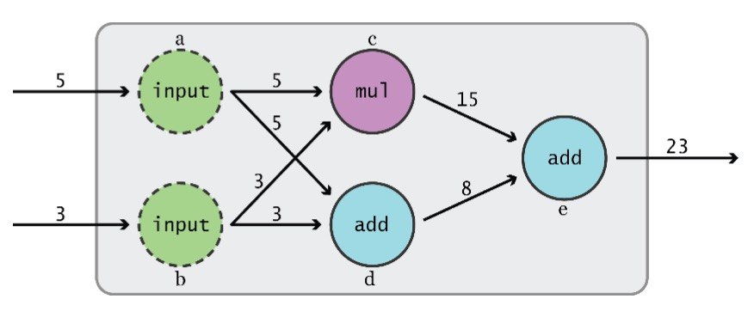
Data Flow Graphs
TensorFlow separates definition of computations from their execution

Slide 17
Getting Started

Slide 18
import tensorflow as tf

Slide 19
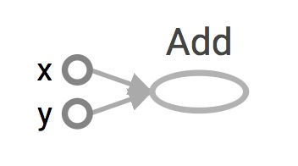
Data Flow Graphs
import tensorflow as tf a = tf.add(3, 5)
Why x, y?
TF automatically names the nodes when you don’t explicitly name them.
x = 3
y = 5

Slide 20
Data Flow Graphs
import tensorflow as tf a = tf.add(3, 5)
3
a
5
>> Tensor("Add:0", shape=(), dtype=int32)
(Not 8)

Slide 21
Because we haven’t created a session!
A Session object encapsulates the environment in which Operation objects are executed, and Tensor objects are evaluated.
Session will also allocate memory to store the current values of variables.

Slide 22
Data Flow Graphs
import tensorflow as tf a = tf.add(3, 5)
with tf.Session() as sess: print(sess.run(a))
3
8
a
5
>> 8

Slide 23
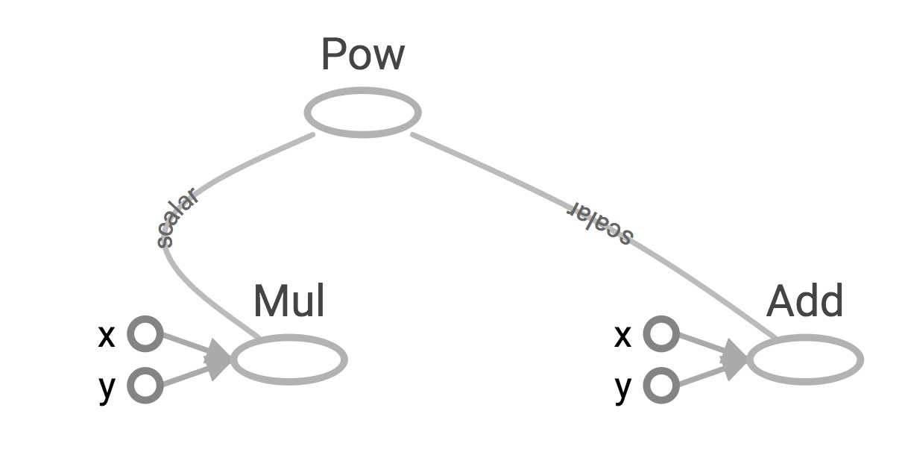
We can select which operation to perform within tf.Session()
x = 2 y = 3 op1 = tf.add(x, y) op2 = tf.multiply(x, y) op3 = tf.pow(op2, op1) with tf.Session() as sess: op3 = sess.run(op3)

Slide 24
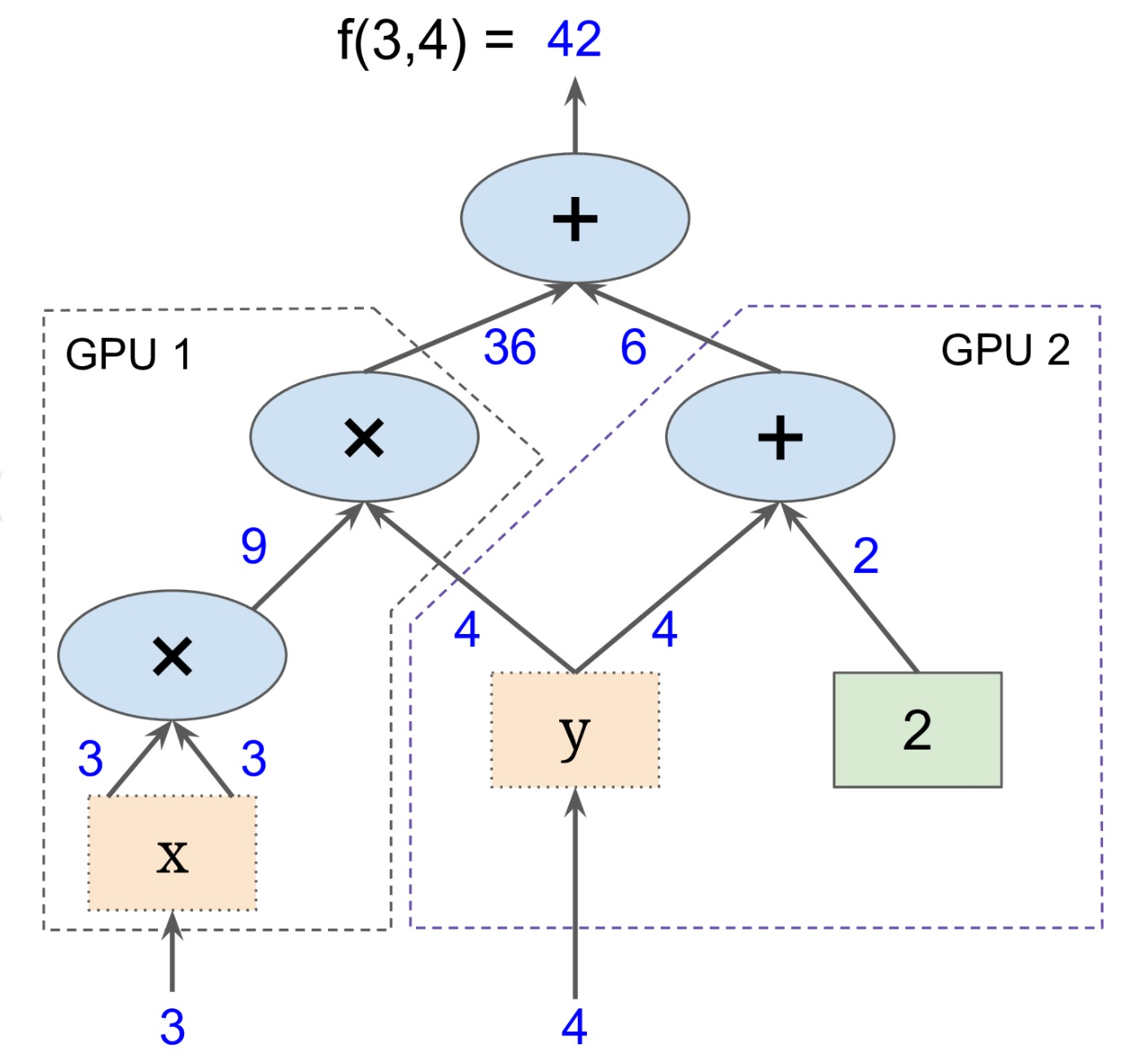
Subgraphs
Possible to break graphs into several chunks and run them parallelly across multiple CPUs, GPUs, TPUs, or other devices.
Example: AlexNet

Slide 25
Distributed Computation
To put part of a graph on a specific CPU or GPU:
# Creates a graph.
with tf.device('/gpu:2'):
a = tf.constant([1.0, 2.0, 3.0, 4.0, 5.0, 6.0], name='a')
b = tf.constant([1.0, 2.0, 3.0, 4.0, 5.0, 6.0], name='b')
c = tf.multiply(a, b)
# Creates a session with log_device_placement set to True.
sess = tf.Session(config=tf.ConfigProto(log_device_placement=True))
# Runs the op.
print(sess.run(c))

Slide 26
What if I want to build more than one graph?

Slide 27
Yeah, You can But you shouldn’t

Slide 28
Multiple graphs require multiple sessions, each will try to use all available resources by default
Can't pass data between them without passing them through python/numpy, which doesn't work in distributed
It’s better to have disconnected subgraphs within one graph
BUG ALERT!

Slide 29
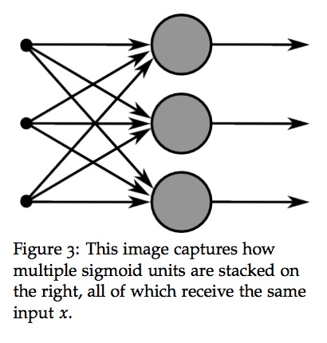
Why Graphs (TensorFlow)
Save computation. Only run subgraphs that lead to the values you want to fetch.
Break computation into small, differential pieces to facilitate auto-differentiation
Facilitate distributed computation, spread the work across multiple CPUs, GPUs, TPUs, or other devices
Many common machine learning models are taught and visualized as directed graphs

Slide 30
Convolutional Neural Networks (CNNs)

Slide 31
Self Driving Car
Object detection
Object segmentation
Pose estimation
Image captioning
Image generation
Art generation

Slide 32
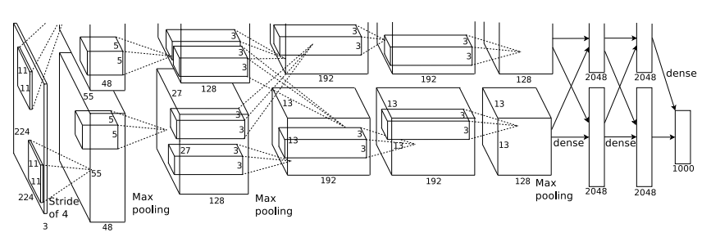
Convolutional Neural Networks

Slide 33
Convolution Layer
32x32x3 image
32
height
32
width
3
depth
Slide credit: CS231n Lecture 7

Slide 34
Convolution Layer
32x32x3 image
Filters always extend the full depth of the input volume
32
height
5x5x3 filter
Convolve the filter with the image
i.e. “slide over the image spatially, computing dot products”
32
width
3
depth
Slide credit: CS231n Lecture 7

Slide 35
Convolution Layer
activation maps
32x32x3 image
5x5x3 filter
32
28
convolve (slide) over all spatial locations
32
28
3
1

Slide 36
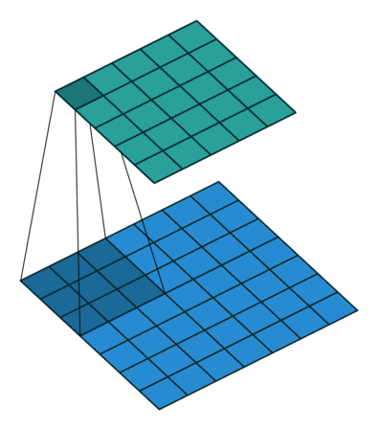

Slide 37
Convolution Layer
activation maps
32x32x3 image
5x5x3 filter
32
28
convolve (slide) over all spatial locations
32
28
3
consider a second, green filter
2

Slide 38
For example, if we had 6 5x5 filters, we’ll get 6 separate activation maps:
activation maps
32
28
Convolution Layer
32
28
3
6
We stack these up to get a new “image” of size 28x28x6!

Slide 39
ConvNet is a sequence of Convolution Layers, interspersed with activation functions
32
28
24
….
CONV,
ReLU
e.g. 6 5x5x3 filters
CONV,
ReLU
e.g. 10 5x5x6 filters
CONV,
ReLU
32
28
24
3
6
10

Slide 40
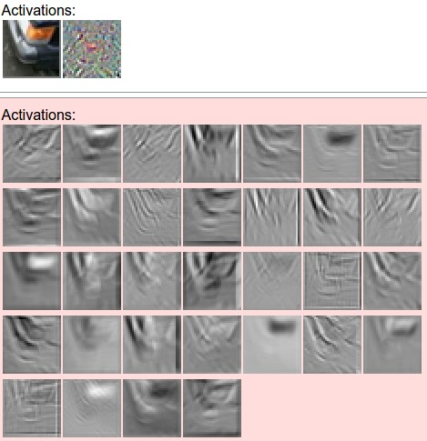
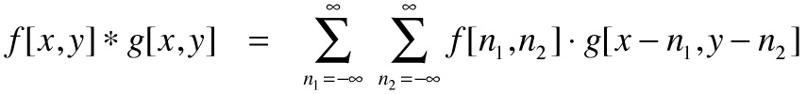
one filter =>
one activation map
example 5x5 filters
(32 total)
We call the layer convolutional because it is related to convolution of two signals:
element-wise multiplication and sum of a filter and the signal (image)
Figure copyright Andrej Karpathy.

Slide 41
A closer look at spatial dimensions:
7
7x7 input (spatially)
assume 3x3 filter
7

Slide 42
A closer look at spatial dimensions:
7
7x7 input (spatially)
assume 3x3 filter
7

Slide 43
A closer look at spatial dimensions:
7
7x7 input (spatially)
assume 3x3 filter
7

Slide 44
A closer look at spatial dimensions:
7
7x7 input (spatially)
assume 3x3 filter
7

Slide 45
A closer look at spatial dimensions:
7
=> 5x5 output
7x7 input (spatially)
assume 3x3 filter
7

Slide 46
A closer look at spatial dimensions:
7
7x7 input (spatially)
assume 3x3 filter
applied with stride 2
7

Slide 47
A closer look at spatial dimensions:
7
7x7 input (spatially)
assume 3x3 filter
applied with stride 2
7

Slide 48
A closer look at spatial dimensions:
7
7x7 input (spatially)
assume 3x3 filter
applied with stride 2
=> 3x3 output!
7

Slide 49
A closer look at spatial dimensions:
7
7x7 input (spatially)
assume 3x3 filter
applied with stride 3?
7

Slide 50
A closer look at spatial dimensions:
7
7x7 input (spatially)
assume 3x3 filter
applied with stride 3?
7
doesn’t fit!
cannot apply 3x3 filter on 7x7 input with stride 3.

Slide 51
N
Output size:
(N - F) / stride + 1
e.g. N = 7, F = 3:
stride 1 => (7 - 3)/1 + 1 = 5
stride 2 => (7 - 3)/2 + 1 = 3
stride 3 => (7 - 3)/3 + 1 = 2.33 :\
F
N
F

Slide 53
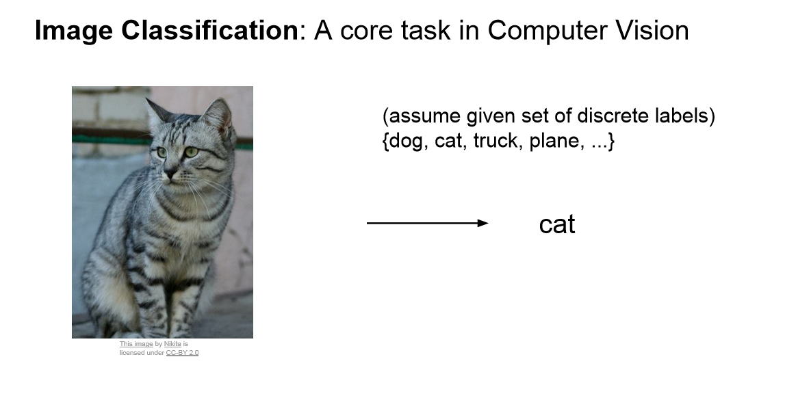

Slide 54
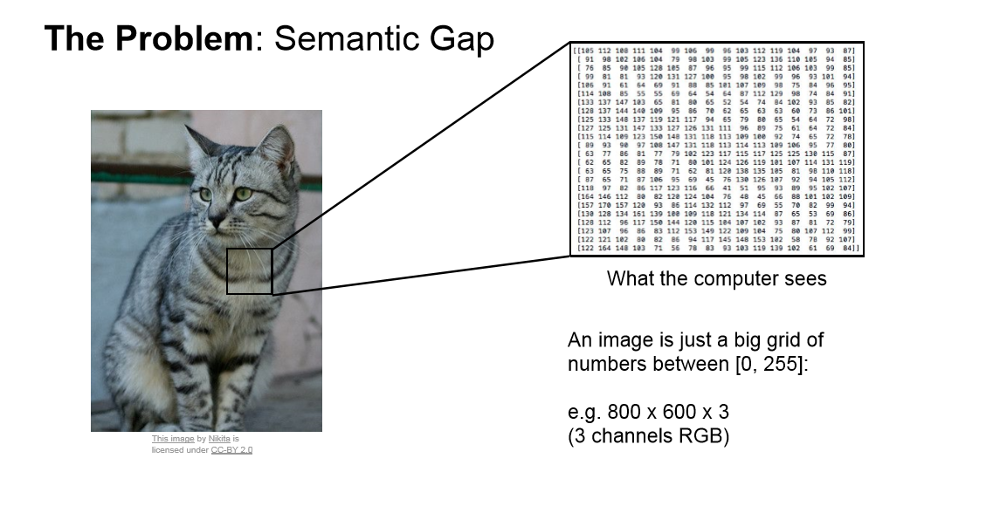

Slide 55
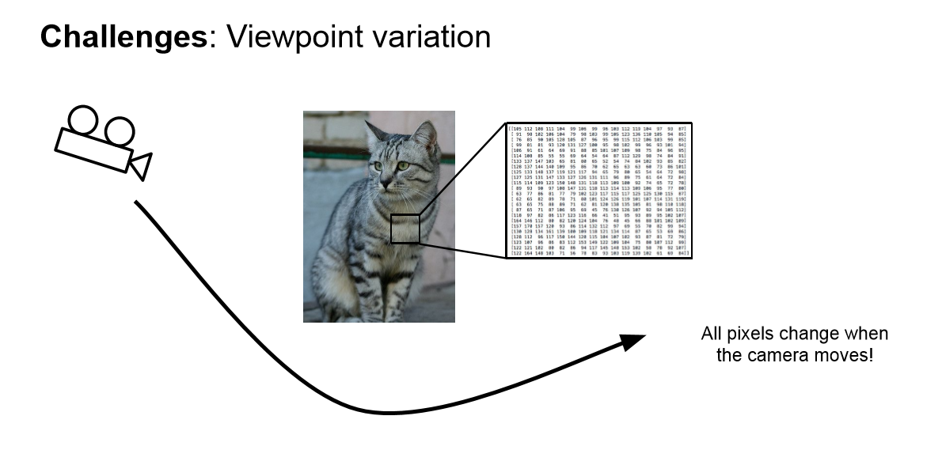

Slide 56
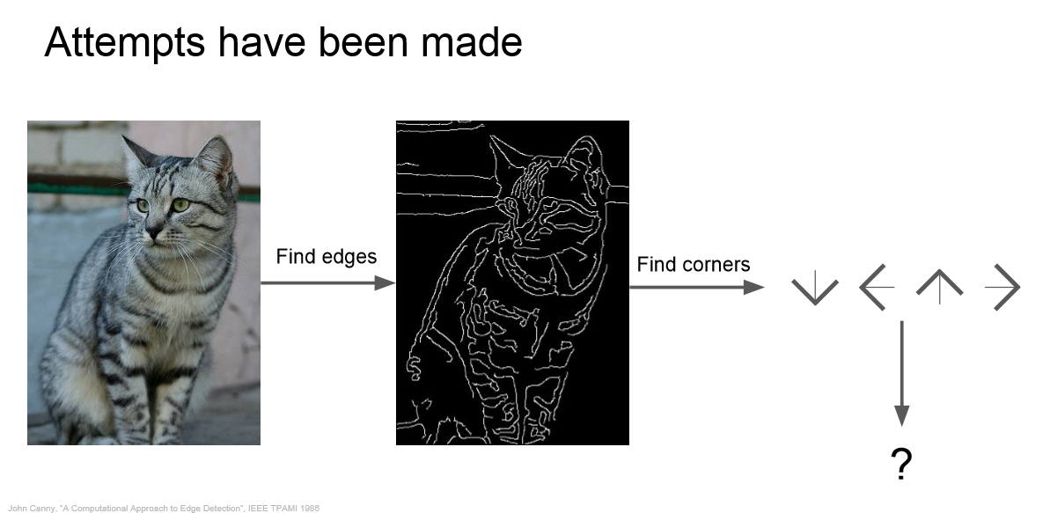

Slide 57
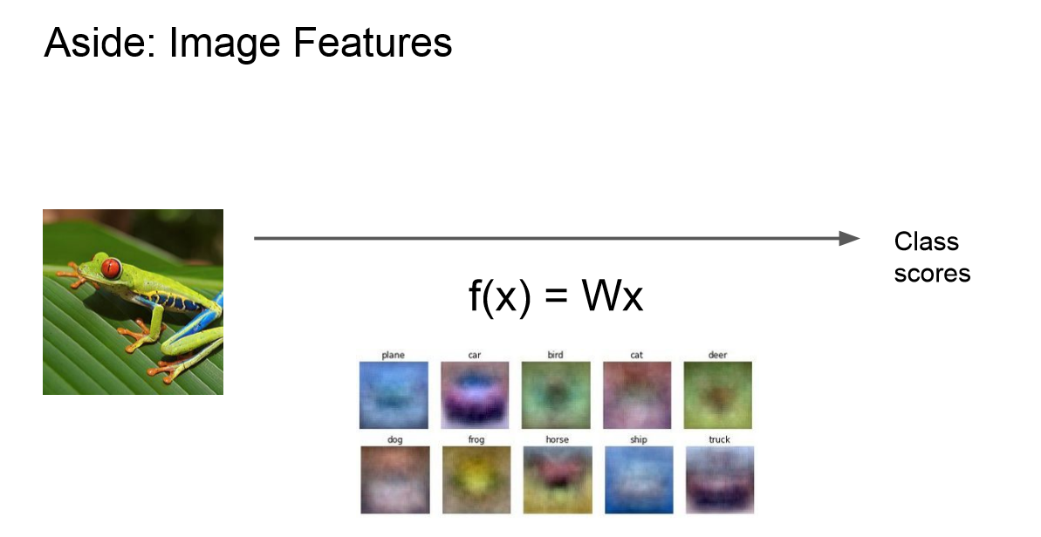

Slide 58
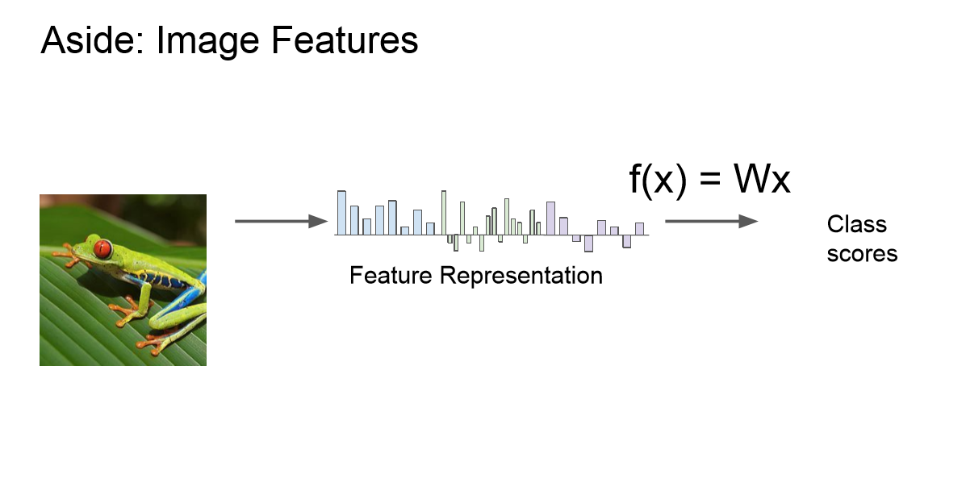

Slide 59
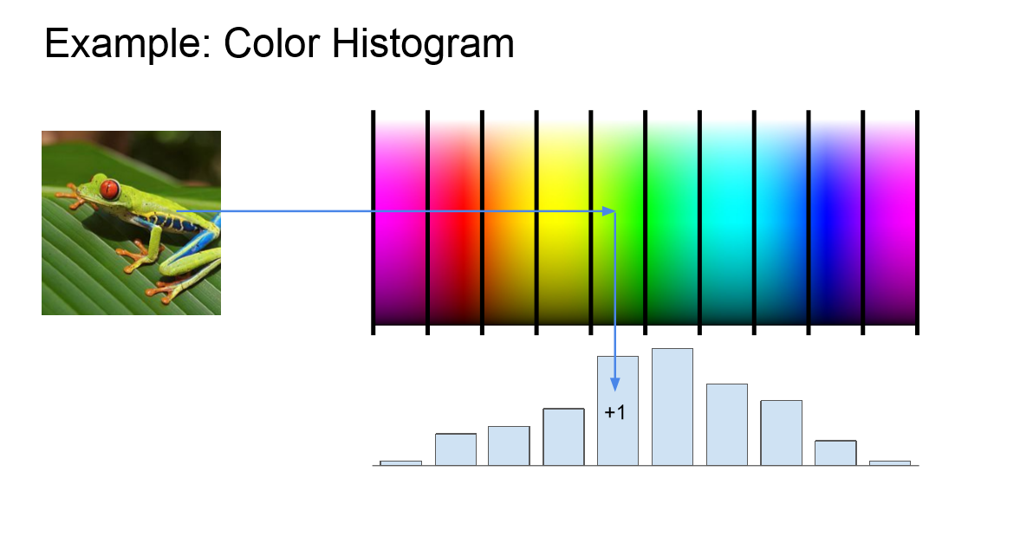

Slide 60
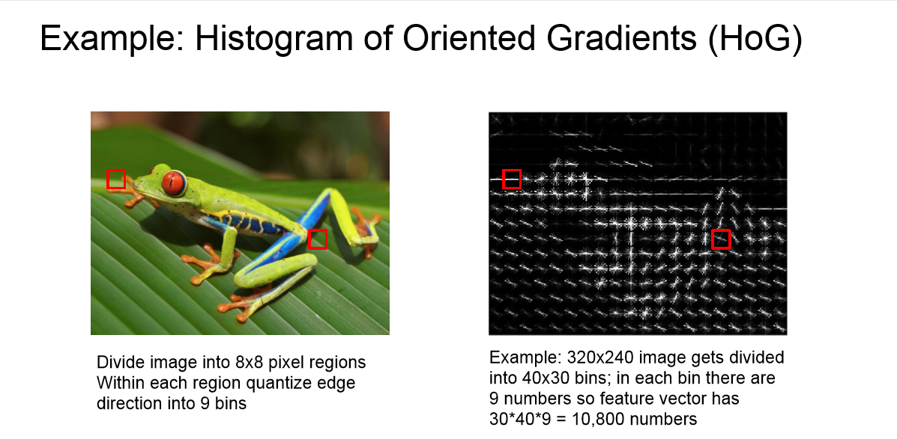

Slide 61
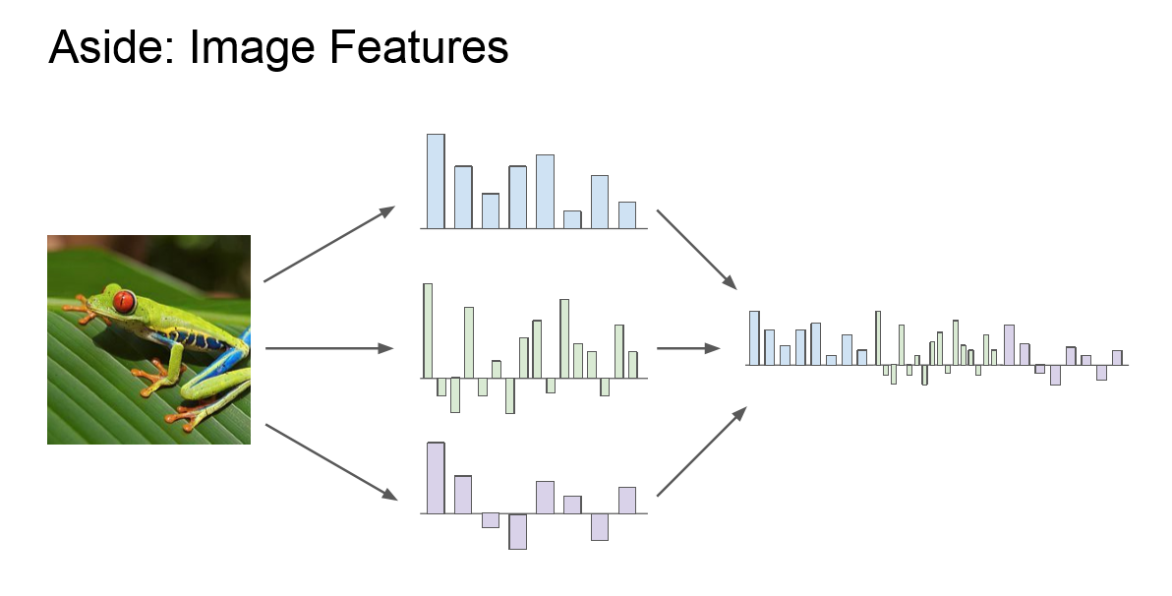

Slide 62
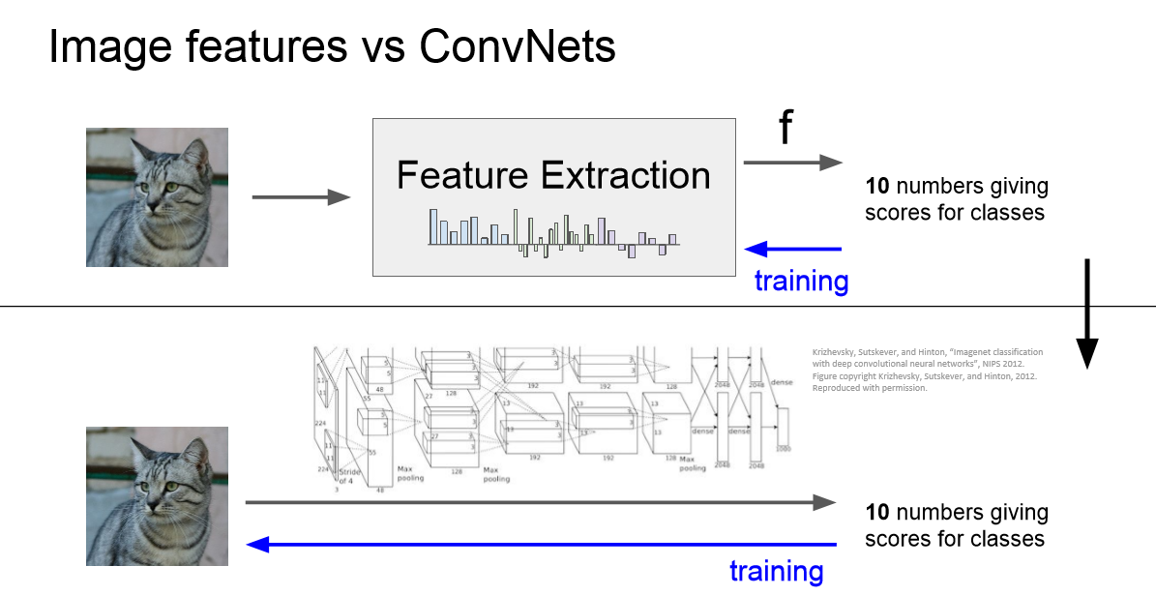

Slide 64
In practice: Common to zero pad the border
0 | 0 | 0 | 0 | 0 | 0
0
0
0
0
e.g. input 7x7
3x3 filter, applied with stride 1
pad with 1 pixel border => what is the output?
(recall:)
(N - F) / stride + 1

Slide 65
In practice: Common to zero pad the border
0 | 0 | 0 | 0 | 0 | 0
0
0
0
0
e.g. input 7x7
3x3 filter, applied with stride 1
pad with 1 pixel border => what is the output?
7x7 output!

Slide 66
In practice: Common to zero pad the border
0 | 0 | 0 | 0 | 0 | 0
0
0
0
0
e.g. input 7x7
3x3 filter, applied with stride 1
pad with 1 pixel border => what is the output?
7x7 output!
in general, common to see CONV layers with stride 1, filters of size FxF, and zero-padding with (F-1)/2. (will preserve size spatially)
e.g. F = 3 => zero pad with 1
F = 5 => zero pad with 2
F = 7 => zero pad with 3

Slide 67
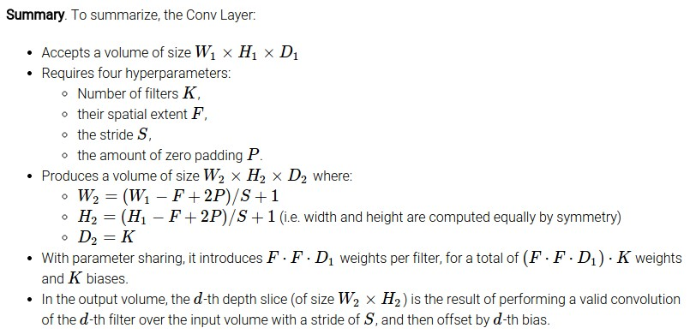

Slide 68
Common settings:
K = (powers of 2, e.g. 32, 64, 128, 512)
F = 3, S = 1, P = 1
F = 5, S = 1, P = 2
F = 5, S = 2, P = ? (whatever fits)
F = 1, S = 1, P = 0

Slide 69
2D Visualization on CNN

Slide 70
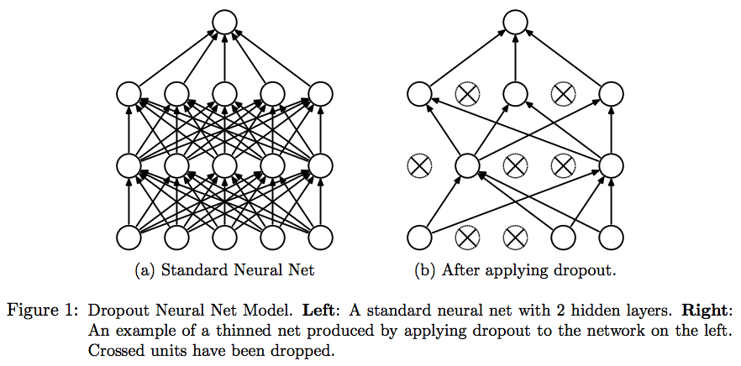
Dropout

Slide 71
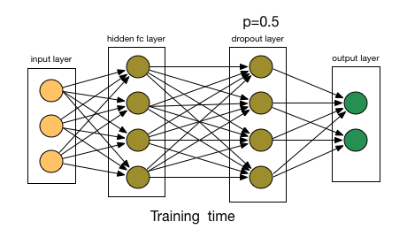

Slide 72

Pooling Layer
Makes the representation smaller and more manageable
Operates over each activation map independently

Slide 73
Max Pooling
Single depth slice
1 | 1 | 2 | 4
5 | 6 | 7 | 8
3 | 2 | 1 | 0
1 | 2 | 3 | 4
x
max pool with
2x2 filters and stride 2
6 | 8
3 | 4
y

Slide 74
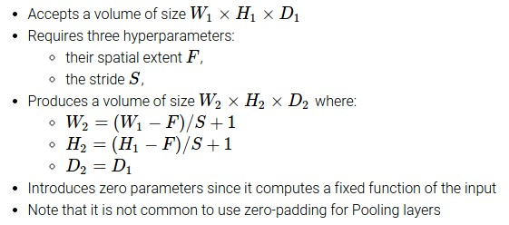
Max Pooling
Common settings:
F = 2, S = 2
F = 3, S = 2

